Slide 1
A FEDERALIST ALTERNATIVE FOR EUROPEAN GOVERNANCE: THE EUROPEAN UNION IN HARD TIMES Sergio Fabbrini Intesa Sanpaolo Chair on European Governance Professor Emeritus, Politics and International Relations Luiss Political Science Department

Slide 2
1. Research questions 2. Brussels in Hard Times 3. The EU Dual Governance Regime 4. The Federalist Alternative for EU Governance 5. National sovereignty in Unions of states 6. Conclusion
Slide statica
Esempio di slide divisoria isitutuzionale (fondo bianco)

Slide 3
1. Research questions
Slide statica
Esempio di slide con testo, max. 250 battute
Sovereign debt crisis, pandemic crisis, energy crisis, military aid crisis: central role played by national governments (European Council and Council)
How did the EU perform during the 2010s and 2020s crises?
Reacting and not acting – divisions among member states - political weakness
Due also to the previous enlargements, the EU is gradually transforming in an international organization centred around the European Council
Is there a federalist alternative for Europen governance?

Slide 4
2. Brussels in hard times
Slide statica
Esempio di slide con testo, max. 250 battute
Post-Maastricht EU introduced different decision-making regimes for the regulatory policies of the single market (supranational governance or SG) and the policies at the core of state sovereignty (intergovernmental governance or IG)
The crises concerned policies (sovereign debt, migration, pandemic, energy, war) to the core of state sovereignty - to be managed intergovernmentally
The institutional center of gravity of IG – European Council and Council
During the crises - divisions within the latter
Divisions based on transnational coalitions –sectional cleavages

Slide 5
3. The EU Dual Governance Regime
Slide statica
Esempio di slide con testo, max. 250 battute
Who decides in the EU? Theoretical underevaluation of the executive’ s deficit
Neo-functionalism and intergovernmentalism: only processes matter
New intergovernmentalism: executive order and not executive power
Executive institutions: Commission (SG) and European Council (IG)
Commission in regulatory policies, European Council in strategic policies
Confusion and unaccountability

Slide 6
4. The Federalist Alternative for European Governance
Federations by disaggregation and aggregation: federal states vs federal unions
Federations by aggregation: the US (distrust through separation of powers – segmented sovereignty)
Federations by disaggregation: Post II WW Germany (parliamentary government and centralized sovereignty)
Limits of executive and parliamentary federalisms
Federation with confederal features: EU perspective

Slide 7
5. National sovereignty in unions of states
Governance differentiation: is the solution?
Sovereignty-induced differentiation: problems
Sovereignty in democratic federations
Because of divisions between states: multi-tier Europe
The central tier: a European federation
The European federation as federal union

Slide 8
6. Conclusions
Culturally dishomogeneous EU
Divisions on sovereignty (east and north vs west and south)
From multi-speed to different tiers
Constitutional differentiation
Federalism through a core (starting from security)
The federalist core in the post-American Europe

Slide 9
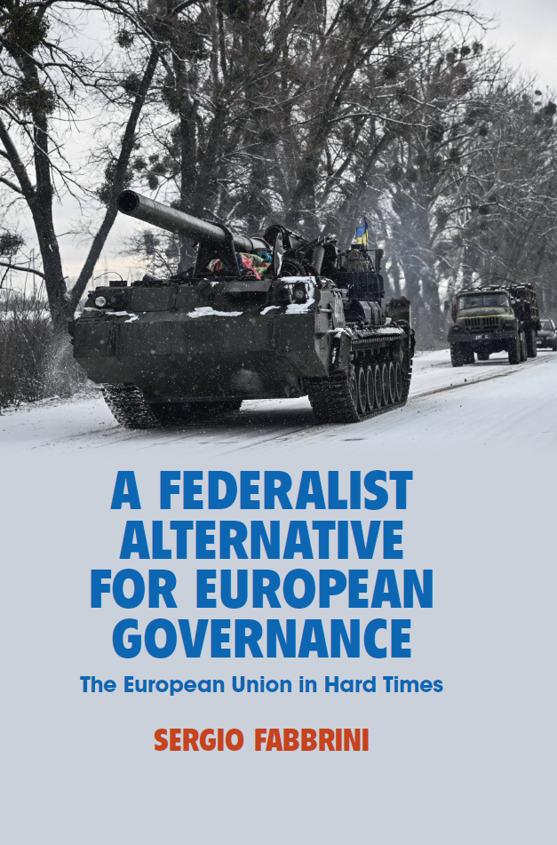
Slide statica
Esempio di slide divisoria isitutuzionale (fondo blu)

